Slide 1

UNIT-1
INTRODUCTION TO PANDAS
PYTHON-PANDAS
UNIT-I
Department of CSE, School of Engineering, Malla Reddy University, Hyderabad.
Notes:
You can safely remove this slide. This slide design was provided by SlideModel.com – You can download more templates, shapes and elements for PowerPoint from http://slidemodel.com

Slide 2

Python Pandas:
Pandas is defined as an open-source library that provides high-performance data manipulation in Python. The name of Pandas is derived from the word Panel Data, which means an Econometrics from Multidimensional data. It is used for data analysis in Python and developed by Wes McKinney in 2008.
01
08
Middle Level
Language
02
Memory
Management
Structured
Language
Data analysis requires lots of processing, such as restructuring, cleaning or merging, etc.
There are different tools are available for fast data processing, such as Numpy, Scipy, Cython, and Panda. But we prefer Pandas because working with Pandas is fast, simple and more expressive than other tools.
Pandas is the backbone for most of the data projects.
We can import the pandas library using the “import pandas” command. We now have access to many pre-built classes and functions.
Speed
03
07
Rich Library
04
Pointers
Extensible
Recursion
05
PYTHON-PANDAS
UNIT-I
Department of CSE, School of Engineering, Malla Reddy University, Hyderabad.

Slide 3
Python Pandas:
Key Features of Pandas
Pandas is built on top of the Numpy package, means Numpy is required for operating the Pandas
It has a fast and efficient DataFrame object with the default and customized indexing.
Used for reshaping and pivoting of the data sets.
Group by data for aggregations and transformations.
It is used for data alignment and integration of the missing data.
Provide the functionality of Time Series.
Process a variety of data sets in different formats like matrix data, tabular heterogeneous, time
series.
Handle multiple operations of the data sets such as subsetting, slicing, filtering, groupBy, re-
ordering, and re-shaping.
It integrates with the other libraries such as SciPy, and scikit-learn.
Provides fast performance, and If you want to speed it, even more, you can use the Cython.
01
08
Middle Level
Language
02
Memory
Management
Structured
Language
Speed
03
07
Rich Library
04
Pointers
Extensible
Recursion
05
PYTHON-PANDAS
UNIT-I
Department of CSE, School of Engineering, Malla Reddy University, Hyderabad.

Slide 4
Benefits of Pandas:
Data Representation:
It represents the data in a form that is suited for data analysis through its DataFrame and Series.
Clear code:
The clear API of the Pandas allows you to focus on the core part of the code. So, it
provides clear and concise code for the user.
01
08
Middle Level
Language
02
Memory
Management
Structured
Language
Speed
03
In order to be able to work with the data in Python, we’ll need to read the data (csv, excel, dictionary...) file into a Pandas Data.frame.
A DataFrame is a way to represent and work with tabular data.
Tabular data has rows and columns, just like our csv file. In order to read in the data, we‟ll need to use pandas.read_csv function. This function will take in a csv file and return a DataFrame.
07
Rich Library
04
Pointers
Extensible
Recursion
05
PYTHON-PANDAS
UNIT-I
Department of CSE, School of Engineering, Malla Reddy University, Hyderabad.

Slide 5
Pandas Data Structure:
The Pandas provides two data structures for processing the data, i.e.,
Series
DataFrame
1) Series
It is defined as a one-dimensional array that is capable of storing various data types. The row labels of series are called the index.
We can easily convert the list, tuple, and dictionary into series using “Series' method.
A Series cannot contain multiple columns.
It has a parameter i.e Data: It can be any list, dictionary, or scalar value.
Creating Series from Array:
Before creating a Series, Firstly, we have to import the numpy module and then use array() function in the program.
01
08
Middle Level
Language
02
Memory
Management
Structured
Language
Speed
03
07
Rich Library
04
Pointers
Extensible
Recursion
05
PYTHON-PANDAS
UNIT-I
Department of CSE, School of Engineering, Malla Reddy University, Hyderabad.

Slide 6
Example-1:
import pandas as pd
import numpy as np
List=[1,2,3,4,5,6]
a = pd.Series(List)
print(a)
Output:
0 1
1 2
2 3
3 4
4 5
5 6
dtype: object
01
08
Middle Level
Language
02
Memory
Management
Structured
Language
Speed
03
07
Rich Library
04
Pointers
Extensible
Recursion
05
PYTHON-PANDAS
UNIT-I
Department of CSE, School of Engineering, Malla Reddy University, Hyderabad.

Slide 7
Example-2:
import pandas as pd
import numpy as np
info = np.array(['P','a','n','d','a','s'])
a = pd.Series(info)
print(a)
Output:
0 P
1 a
2 n
3 d
4 a
5 s
dtype: object
01
08
Middle Level
Language
02
Memory
Management
Structured
Language
Speed
03
07
Rich Library
04
Pointers
Extensible
Recursion
05
PYTHON-PANDAS
UNIT-I
Department of CSE, School of Engineering, Malla Reddy University, Hyderabad.

Slide 8
Example-3:
import pandas as pd
import numpy as np
mytuple = ("apple", "banana", "cherry")
print(mytuple)
ts=pd.Series ( mytuple)
print(a)
Output:
01
08
Middle Level
Language
02
Memory
Management
Structured
Language
Speed
03
07
Rich Library
04
Pointers
Extensible
Recursion
05
PYTHON-PANDAS
UNIT-I
Department of CSE, School of Engineering, Malla Reddy University, Hyderabad.

Slide 9
Example-4:
import pandas as pd
import numpy as np
thisdict = {
"brand": "Ford"
"model": "Mustang","jogesh"
"year": 1964,
}
ds=pd.Series(thisdict)
01
08
Middle Level
Language
02
Memory
Management
Structured
Language
Speed
03
07
Rich Library
04
Pointers
Extensible
Recursion
05
PYTHON-PANDAS
UNIT-I
Department of CSE, School of Engineering, Malla Reddy University, Hyderabad.

Slide 10
Series syntax :
pandas.Series(data=None, index=None, dtype=None, name=None, copy=False, fastpath=False)
Parameters:
data: array- Contains data stored in Series.
index: array-like or Index (1d)
dtype: str, numpy. dtype, or Extension Dtype, optional
name: str, optional
copy: bool, default False
01
08
Middle Level
Language
02
Memory
Management
Structured
Language
Speed
03
07
Rich Library
04
Pointers
Extensible
Recursion
05
PYTHON-PANDAS
UNIT-I
Department of CSE, School of Engineering, Malla Reddy University, Hyderabad.

Slide 11
Series functions :
Count: Return number of non-NA/null observations in the Series.
s = pd.Series([0.0, 1.0, np.nan])
s.count()
2. size: Return the number of elements in the underlying data.
s.size()
3. pop: Return item and drops from series. Raise KeyError if not found.
s.pop(0)
01
08
Middle Level
Language
02
Memory
Management
Structured
Language
Speed
03
07
Rich Library
04
Pointers
Extensible
Recursion
05
PYTHON-PANDAS
UNIT-I
Department of CSE, School of Engineering, Malla Reddy University, Hyderabad.

Slide 12
Series functions :
4. Add : Return Addition of series and other, element-wise (binary operator add).
Equivalent to series + other, but with support to substitute a fill_value for missing data in either one of the inputs.
Example:
01
08
b = pd.Series([1, np.nan, 1, np.nan], index=['a', 'b', 'd', 'e'])
Print( b)
a 1.0
b NaN
d 1.0
e NaN
dtype: float64
a = pd.Series([1, 1, 1, np.nan], index=['a', 'b', 'c', 'd'])
Print( a)
a 1.0
b 1.0
c 1.0
d NaN
dtype: float64
Middle Level
Language
02
Memory
Management
Structured
Language
Speed
03
07
Rich Library
a.add(b, fill_value=0)
a 2.0
b 1.0
c 1.0
d 1.0
e NaN
dtype: float64
04
Pointers
Extensible
Recursion
05
PYTHON-PANDAS
UNIT-I
Department of CSE, School of Engineering, Malla Reddy University, Hyderabad.

Slide 13
Python Pandas DataFrame:
It is a widely used data structure of pandas and works with a two-dimensional array with labelled axes (rows and columns). DataFrame is defined as a standard way to store data and has two different indexes, i.e., row index and column index. It consists of the following properties:
The columns can be heterogeneous types like int, bool, and so on.
It can be seen as a dictionary of Series structure where both the rows and columns are
indexed. It is denoted as "columns" in case of columns and "index" in case of rows.
Create a DataFrame using List:
We can easily create a DataFrame in Pandas using list.
import pandas as pd
# a list of strings
x = ['Python','Pandas']
# Calling DataFrame constructor on list
df = pd.DataFrame(x)
print(df)
01
08
Middle Level
Language
02
Memory
Management
Structured
Language
Speed
03
07
Rich Library
04
Pointers
Output:
0
0 python
1 pandas
Extensible
Recursion
05
PYTHON-PANDAS
UNIT-I
Department of CSE, School of Engineering, Malla Reddy University, Hyderabad.

Slide 14
Data Frame syntax :
pandas.DataFrame(data=None, index=None, columns=None, dtype=None, copy=None)
Data : ndarray (structured or homogeneous), Iterable, dict, or DataFrame
Dict can contain Series, arrays, constants, dataclass or list-like objects. If data is a dict, column order follows insertion-order. If a dict contains Series which have an index defined, it is aligned by its index.
Index: Index to use for resulting frame. Will default to Range Index if no indexing information part of input data and no index provided.
Column : labels to use for resulting frame when data does not have them, defaulting to Range Index(0, 1, 2, …, n). If data contains column labels, will perform column selection instead.
Data type : Data type to force. Only a single dtype is allowed. If None, infer.
01
08
Middle Level
Language
02
Memory
Management
Structured
Language
Speed
03
07
Rich Library
04
Pointers
Extensible
Recursion
05
PYTHON-PANDAS
UNIT-I
Department of CSE, School of Engineering, Malla Reddy University, Hyderabad.

Slide 15
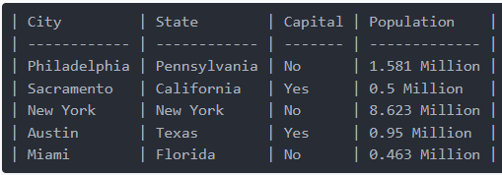
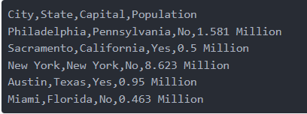
What is csv ?:
csv stands for comma-separated values, a delimiter, usually a comma, separates columns within each row.
A CSV file stores tabular data in plain text.
Each line of the file is a data record.
Each record consists of one or more fields, separated by commas
01
08
Middle Level
Language
02
Memory
Management
Structured
Language
Data Frame
03
Speed
CSV file
07
Rich Library
04
Pointers
Extensible
Recursion
05
PYTHON-PANDAS
UNIT-I
Department of CSE, School of Engineering, Malla Reddy University, Hyderabad.

Slide 16
Reading and Writing CSV Files using Pandas:
Pandas is a very powerful and popular framework for data analysis and manipulation.
One of the most striking features of Pandas is its ability to read and write various types of files including CSV and Excel.
You can effectively and easily manipulate CSV files in Pandas using functions like read_csv() and to_csv() .
Installing Pandas
We have to install Pandas before using it. Let's use pip in Jupyter notebook
01
08
Middle Level
Language
02
Memory
Management
Structured
Language
Speed
03
07
Rich Library
04
Pointers
pip install pandas
Extensible
Recursion
05
PYTHON-PANDAS
UNIT-I
Department of CSE, School of Engineering, Malla Reddy University, Hyderabad.

Slide 17
Reading CSV Files with read_csv():
How to read the csv file using pandas:
Once the pandas library is imported by using import statement with out any error.
That assumes the library is installed. Then we can load a csv file using the pandas built-in function “pandas.read_csv()”
We simply type the word pandas (or) object of pandas, then a dot and name of the read_csv() function with arguments (or ) with out arguments.
01
08
Middle Level
Language
02
Import pandas as pd
Memory
Management
Structured
Language
Speed
03
07
Rich Library
04
Pointers
Extensible
Recursion
df=pd.read_csv(“path of file, where it is located”)
05
PYTHON-PANDAS
UNIT-I
Department of CSE, School of Engineering, Malla Reddy University, Hyderabad.

Slide 18
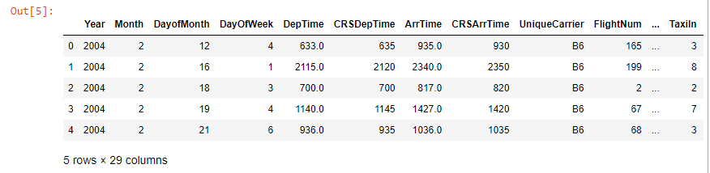
Example for read the csv file using pandas :
import pandas as pd
df=pd.read_csv(r"C:\Users\Documents\R programs\airline-data.csv")
df.head(5)
Output:
01
08
Middle Level
Language
02
Memory
Management
Structured
Language
Speed
03
07
Rich Library
04
Pointers
Extensible
Recursion
NOTE: we need to give the path of the csv file as argument to the read_csv function, to read the path string correctly we need to use “r” as a prefix to the command.
05
PYTHON-PANDAS
UNIT-I
Department of CSE, School of Engineering, Malla Reddy University, Hyderabad.

Slide 19
Example for read the EXCEL file using pandas :
import pandas as pd
df=pd.read_excel(r"C:\Users\Documents\R programs\data.xlsx")
df.head(5)
Output:
01
08
Middle Level
Language
02
Memory
Management
Structured
Language
Speed
03
07
Rich Library
04
Pointers
Extensible
Recursion
05
PYTHON-PANDAS
UNIT-I
Department of CSE, School of Engineering, Malla Reddy University, Hyderabad.

Slide 20
Writing CSV Files with to_csv():
DataFrames are tabular. Turning a DataFrame into a CSV file is as simple by using to_csv(“location of the path).
When writing a DataFrame to a CSV file, you can also change the column names, using the columns argument, or specify a delimiter via the sep argument. If you don't specify either of these, you'll end up with a standard Comma-Separated Value file.
Example:
import pandas as pd
cities = pd.DataFrame([['Sacramento', 'California'], ['Miami', 'Florida']], columns=['City', 'State'])
cities.to_csv(r'C:\Users\Desktop\new\cities.csv')
Output: after executing check new folder on the desktop, then find out the cities.csv file
01
08
Middle Level
Language
02
Memory
Management
Structured
Language
Speed
03
07
Rich Library
04
Pointers
Extensible
Recursion
05
PYTHON-PANDAS
UNIT-I
Department of CSE, School of Engineering, Malla Reddy University, Hyderabad.

Slide 21

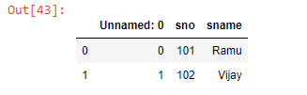
Example 2: (create and write csv file of student):
# create csv file with out data
import pandas as pd
student1 = pd.DataFrame(columns=['sno', 'sname'])
student1.to_csv(r'C:\Users\RamaraoT\Desktop\new\student1.csv')
# Create and Writing data in a csv file.
import pandas as pd
student = pd.DataFrame([[101, ‘Jay'], [102, 'Vijay']], columns=['sno', 'sname'])
student.to_csv(r'C:\Users\RamaraoT\Desktop\new\student.csv')
01
08
Middle Level
Language
02
Memory
Management
Structured
Language
Speed
03
07
Rich Library
04
Pointers
Extensible
Recursion
05
PYTHON-PANDAS
UNIT-I
Department of CSE, School of Engineering, Malla Reddy University, Hyderabad.

Slide 22

Read cities.csv file:
df = pd.read_csv(r'C:\Users\Desktop\new\cities.csv')
print(df)
Output:
Writing EXCEL Files with to_excel():
import pandas as pd
cities1 = pd.DataFrame([['Sacramento', 'California'], ['Miami', 'Florida']], columns=['City', 'State'])
cities1.to_excel(r'C:\Users\RamaraoT\Desktop\new\cities1.xlsx')
Output: after executing check new folder on the desktop, then find out the cities1.xlsx file
01
08
Middle Level
Language
02
Memory
Management
Structured
Language
Speed
03
07
Rich Library
04
Pointers
Extensible
Recursion
05
PYTHON-PANDAS
UNIT-I
Department of CSE, School of Engineering, Malla Reddy University, Hyderabad.

Slide 23
GroupBy and Summarize the data in pandas with example:
Groupby is a pretty simple concept. We can create a grouping of categories and apply a function to the categories. It’s a simple concept but it’s an extremely valuable technique that’s widely used in data science.
Pandas dataframe.groupby() function is used to split the data set into groups based on some criteria.
Groupby mainly refers to a process involving one or more of the following steps they are:
Splitting : It is a process in which we split data into group by applying some conditions on datasets.
Applying : It is a process in which we apply a function to each group independently
Combining : It is a process in which we combine different datasets after applying groupby and results into a data structure.
01
08
Middle Level
Language
02
Memory
Management
Structured
Language
Speed
03
07
Rich Library
04
Pointers
Extensible
Recursion
05
PYTHON-PANDAS
UNIT-I
Department of CSE, School of Engineering, Malla Reddy University, Hyderabad.

Slide 24
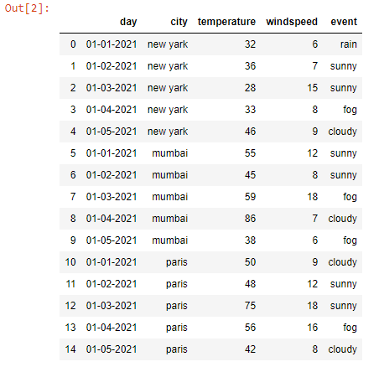
Read Original csv file by using read_csv() function:
# read Original CSV file
import pandas as pd
df=pd.read_csv(r"C:\Users\RamaraoT\Desktop\new\whetherdata.csv")
df
01
08
Middle Level
Language
02
Memory
Management
Structured
Language
Speed
03
07
Rich Library
04
Pointers
Extensible
Recursion
05
PYTHON-PANDAS
UNIT-I
Department of CSE, School of Engineering, Malla Reddy University, Hyderabad.

Slide 25
Apply groupby() function on the above csv file:
# apply groupby on city
g=df.groupby("city")
g
Meaning of this output means entire data set is splitted into groups based on city i.e
01
08
Middle Level
Language
02
Memory
Management
Structured
Language
Speed
03
Mumbai data set
Rich Library
whetherdata
07
new yark data set
04
Pointers
Extensible
Recursion
Paris data set
05
PYTHON-PANDAS
UNIT-I
Department of CSE, School of Engineering, Malla Reddy University, Hyderabad.

Slide 26
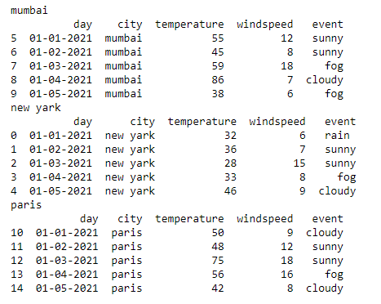
If we want to print executed groupby() data set:
# apply for loop
for city,city_df in g:
print(city) # print name of city
print(city_df) # print data set in city
01
08
Middle Level
Language
02
Memory
Management
Structured
Language
Speed
03
07
Rich Library
04
Pointers
Extensible
Recursion
05
PYTHON-PANDAS
UNIT-I
Department of CSE, School of Engineering, Malla Reddy University, Hyderabad.

Slide 27
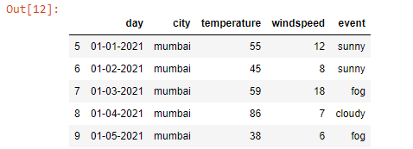
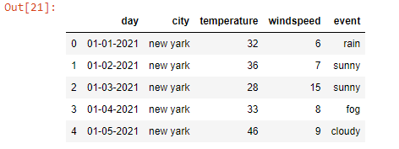
Read specific city data set by using get_group() function:
# Here ‘g’ stores entire data set
# parameter indicate specific city
g.get_group('mumbai')
# Here ‘g’ stores entire data set
# parameter indicate specific city
g.get_group(‘new yark')
01
08
Middle Level
Language
02
Memory
Management
Structured
Language
Speed
03
07
Rich Library
04
Pointers
Extensible
Recursion
05
PYTHON-PANDAS
UNIT-I
Department of CSE, School of Engineering, Malla Reddy University, Hyderabad.

Slide 28
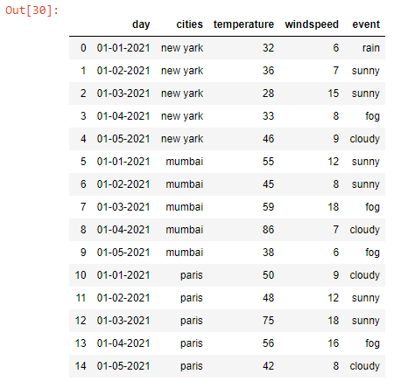
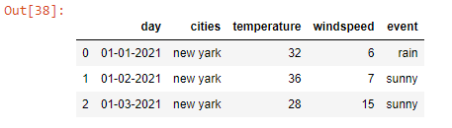
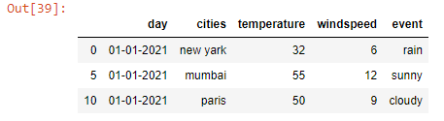
Change name of the column by using rename():
# Entire data set is stored in df
df.rename(columns={'city':'cities'},inplace=True)
df
# apply head() function output is different on Original data set and groupby data set
df.head(3) # read first 3 row’s from original data set
g.head(1) # select 1 row from every group
01
08
Middle Level
Language
Memory
Management
Speed
07
Pointers
Recursion
05
PYTHON-PANDAS
UNIT-I
Department of CSE, School of Engineering, Malla Reddy University, Hyderabad.

Slide 29
Summarize data in pandas (Or) Descriptive Statistics for Pandas DataFrame:
Summarize means to combine the data from different groups. It is also called as aggregation.
different functions used to summarize data contained in a pandas dataframe. Such as
min()
max()
mean()
median()
sum()
count()
describe()
01
08
Middle Level
Language
02
Memory
Management
Structured
Language
Speed
03
07
Rich Library
04
Pointers
Extensible
Recursion
05
PYTHON-PANDAS
UNIT-I
Department of CSE, School of Engineering, Malla Reddy University, Hyderabad.

Slide 30
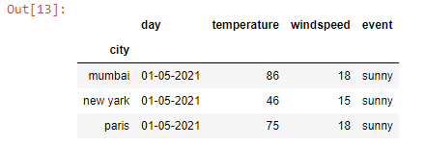
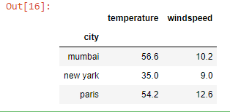
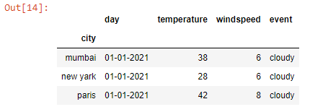
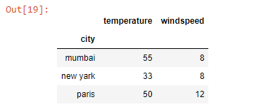
Summarize():
# Here ‘g’ stores entire data set
# indicate specific city
g.max()
g.min()
# Here ‘g’ stores entire data set
# indicate specific city
g.mean()
g.median()
01
08
Middle Level
Language
02
Memory
Management
Structured
Language
Speed
03
07
Rich Library
04
Pointers
Extensible
Recursion
05
PYTHON-PANDAS
UNIT-I
Department of CSE, School of Engineering, Malla Reddy University, Hyderabad.

Slide 31
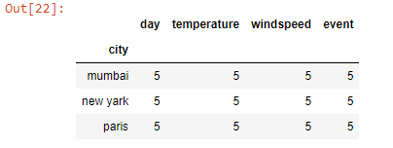
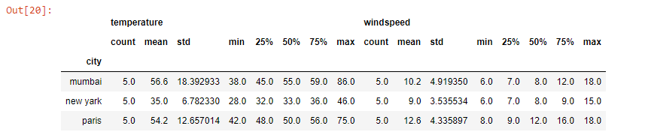
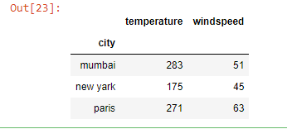
Read specific city data set by using df.get_group() function:
# Here ‘g’ stores entire data set
# indicate specific city
g.describe()
g.count()
g.sum()
01
08
Middle Level
Language
02
Memory
Management
Structured
Language
Speed
03
07
Rich Library
04
Pointers
Extensible
Recursion
05
PYTHON-PANDAS
UNIT-I
Department of CSE, School of Engineering, Malla Reddy University, Hyderabad.

Slide 32

www.mallareddyuniversity.com
Notes:
You can safely remove this slide. This slide design was provided by SlideModel.com – You can download more templates, shapes and elements for PowerPoint from http://slidemodel.com

